Slide 1


Enerģētika Horizonts 2020
Secure, clean and efficient energy
Viedās pilsētas u.c. piedāvājumi
2014.gada 20.novembrī,
STEP-UP projekta konference
Dina Bērziņa, Latvijas NKP vecākā eksperte

Slide 2
Programmas evolūcija
Horizonts 2020 Enerģētikas programma ir divu iepriekšējo Ietvara programmu apvienojums: 7.IP “Enerģētika” un KIP “Saprātīga enerģija Eiropai” (CIP IEE)
Programmas realizācija ar apakšlīgumu (framework contract) tiks nodota INEA un EASME Izpildaģentūrām (kā tas jau bija CIP IEE)
Visās H2020 sadaļās tiek realizēta 2-gadu Darba programma: pašlaik 2014.-2015., tiek gatavota 2016.-2017.

Slide 3
Secure, clean and efficient energy in H2020
designed by merging: FP7 “Energy” and CIP “Intelligent Energy Europe” (CIP IEE):
  Topics EE4, EE5, EE7, EE8, EE9, EE10, EE14, EE15, EE16, EE17, EE19, EE20, EE21, LCE4, LCE14 and ‘Other Actions’ come from IEE
2 responsible DGs:
  DG ENER (units C2 and C3 responsible for EE, SCC and the parts “grids” and “storage” in LCE);
  DG RTD (units G1, G2, G3, G4 – the rest)
2 implementing Executive Agencies:
  INEA - Innovation and Network Executive Agency (ex TEN-TEA)
  EASME - Executive Agency for Small and Medium Enterprises (ex EACI)
Two-year Work Programmes: currently 2014-2015, under preparation 2016-2017

Slide 4
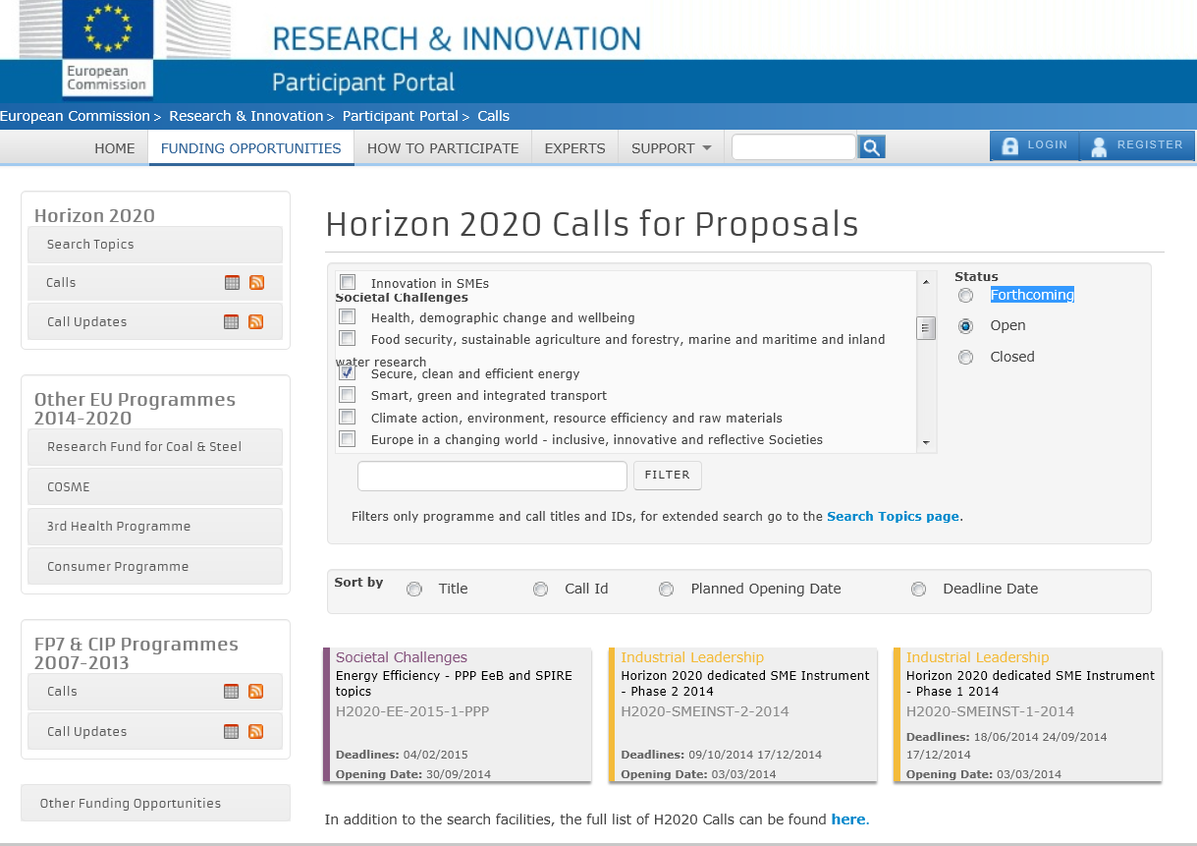
Enerģētikas Projektu konkursi
Energy Calls (Open) 1

Slide 5
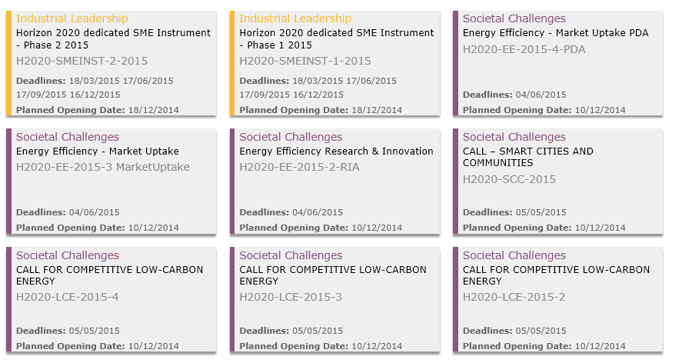
Enerģētikas Projektu konkursi
Energy Calls (Forthcoming) 2

Slide 6
Enerģētikas Projektu konkursi
Energy Calls 3
• EE-06-2015: Demand response in blocks of buildings
• EE-11-2015: New ICT-based solutions for energy efficiency
• EE-13-2015: Technology for district heating and cooling
• EE-20-2015: Project development assistance for innovative bankable and aggregated sustainable energy investment schemes and projects
• LCE-03-2015: Demonstration of renewable electricity and heating/cooling technologies
• LCE-04-2015: Market uptake of existing and emerging renewable electricity, heating and cooling technologies
• LCE-05-2015: Innovation and technologies for the deployment of meshed off-shore grids
• LCE-06-2015: Transmission grid and wholesale market
• LCE-09-2015: Large scale energy storage
• LCE-12-2015: Demonstrating advanced biofuel technologies
• LCE-13-2015: Partnering with Brazil on advanced biofuels
• LCE-14-2015: Market uptake of existing and emerging sustainable bioenergy
• LCE-18-2015: Supporting Joint Actions on demonstration and validation of innovative energy solutions
• LCE-19-2015: Supporting coordination of national R&D activities
• LCE-21-2015: Modelling and analysing the energy system, its transformation and impacts
• LCE-23-2015: Supporting the community in deploying a common framework for measuring the energy and environmental efficiency of the ICT-sector
• SCC-01-2015: Smart Cities and Communities solutions integrating energy, transport, ICT sectors through lighthouse (large scale demonstration - first of the kind) projects
• SCC-03-2015: Development of system standards for smart cities and communities solutions

Slide 7
Budžets / Budget
Projektu konkursi | 2014 (M€) | 2015 (M€)
Energy Efficiency | 97,5 | 98,15
Smart Cities and Communities | 92,32 | 108,18
Competitive Low-Carbon Energy | 359,1 | 372,33
Kopā: | 548,92 | 578,66
Vēl papildus finansējums sadaļās: SMEs and Fast Track to Innovation, EurAtom Fission

Slide 8
Enerģētika/ Energy in H2020 1

Slide 9
Enerģētika/ Energy in H2020 2
Meklēšana pēc temata / Search by:
Energy -(ec.europa.eu/research/participants/portal/desktop/en/opportunities/h2020/search/search_topics.html):
  31 results for Open Calls;
  51 results for Forthcoming Calls
Energy Efficiency – 15 / 23 results
Smart Cities – 4 / 8 results
Innovation and territorial cooperation – 0
SEAP actions - 0

Slide 10
Saistoši temati / Some Topics 1
EE 6-2015– Demand response in blocks of buildings
  (inovāciju projekti - 70%);
EE 13-2015 – Technology for district heating and cooling
  (pētniecības projekti - 100%);
LCE 3-2015 – Demonstration of renewable electricity and heating/cooling technologies
  (inovāciju projekti - 70%);
LCE 18-2015 – Supporting Joint Actions on demonstration and validation of innovative energy solutions
  (ERA-NET Cofund- 33%);
LCE 23-2015 – Supporting the community in deploying a common framework for measuring the energy and environmental efficiency of the ICT-sector
  (koordinācijas/atbalsta darbības - 100%);

Slide 11
Saistoši temati / Some Topics 2
SCC 1-2015 – Smart Cities and Communities solutions integrating energy, transport, ICT sectors through lighthouse (large demo) projects ~ lieli Viedo pilsētu demonstrācijas projekti, kuros integrētas enerģētikas, transporta, informācijas un komunikācijas tehnoloģiju nozares
  (inovāciju projekti - 70%); obligāti skatīt 2014.gadā finansētos projektus
SCC 3-2015 – Development of system standards for smart cities and communities solutions
  (koordinācijas/atbalsta darbības - 100%)

Slide 12
Viedas pilsētas jēdziens
Viedai pilsētai ir dažādas definīcijas:
  šaurāka: IT rīku izmantošana pilsētpārvaldē,
  plašāka: ekonomiska resursu izmantošana visās nozarēs, t.sk. energoefektivitāte,
  integrēta: ieguldījumi cilvēkkapitālā un infrastruktūrā, lai celtu dzīves līmeni un iesaistītu iedzīvotājus pārvaldē,
  alternatīva: attīstīt pilsētai pieguļošās teritorijas, lai iedzīvotāji masveidā nepārceltos uz attīstītajām pilsētām

Slide 13
Concept of Smart City
Several approaches could be found:
  narrow view: cities which use ICT to deliver services to their citizens;
  broader view: cities which efficiently use resources across all sectors resulting in cost and energy savings, improved service and quality of life, and supporting innovation, smart technologies and the low-carbon economy leading to CO₂ neutrality;
  integrated approach: investments in human and social capital along with transport and modern ICT infrastructure secure sustainable economic development and high quality of life, with a wise management of natural resources through participatory governance;
  alternative approach: substantial attention is devoted to the role of social capital in urban development – smart city’s community has learned to learn, adapt and innovate thereby shifting towards knowledge-based economy.

Slide 14
Viedas pilsētas Horizontā 2020
SCC 1 – 2015
apskata 3 integrāli saistītas un neatdalāmas jomas zemas oglekļa emisijas pilsētu (tās rajonu) veidošanā: plaši paraugprojektu (light house) demonstrējumi, kad esošās tehnoloģijas vai to izstrādes pēdējā stadijā (close to the market) tiek integrētas novatoriskā veidā:
  (nulles) vai zema enerģijas patēriņa rajoni: vietējo enerģijas resursu izmantošana, aktīva patērētāju iesaistīšana; rentabla esošo dzīvojamo ēku renovācija ar ilgtspējīgiem materiāliem; IKT risinājumu pielietošana pilsētplānošanā, enerģētikas pārvaldībā un transporta sistēmas uzlabošanā,
  integrēta infrastruktūra: esošo infrastruktūras daļu fiziska integrācija - ielu apgaismojums, rūpnieciskas teritorijas; sinerģija starp elektropārvades viedtīkliem, platjoslas infrastruktūru, centralizētu siltumapgādi un/vai dzesēšanu,
  ilgtspējīga transporta sistēma (mobilitāte): ar alternatīvo degvielu darbināmu transporta līdzekļu uzpildes infrastruktūra - ietekme uz elektroenerģijas tīklu liela elektromobiļu skaita gadījumā, nodrošinājums ar alternatīvās degvielas maisījuma uzpildi, ...

Slide 15
Viedas pilsētas Horizontā 2020
SCC 1 –2015
Smart Cities and Communities solutions integrating energy, transport, ICT sectors through lighthouse (large scale demonstration) projects:
  (Nearly zero) or low energy districts: energy supply by predominant local resources; cost-effective refurbishment of existing buildings; cross-cutting ICT solutions for the design and overall management of energy/ transport systems;
  Integrated Infrastructures: integration of physical infrastructures (core networks, street scenes, lighting, industrial sites, etc.) for re-use and repurposing – leading to quantifiable benefits; exploitation of synergies between requirements for smart grids, broadband infrastructures and in general poly networks (e.g. district heating and cooling);
  Sustainable urban mobility: integration of energy/ fuelling infrastructure with vehicle fleets powered by alternative energy carriers for public and private transport, including logistics and freight-distribution - implications on energy management; e.g.: electromobility - the impact on the electricity grid, of the deployment of high numbers of vehicles and/or the alternative fuel blends...

Slide 16
Viedas pilsētas Horizontā 2020
some additional info...
  for Innovation actions:
    Excellence - Extent that proposed work is ambitious, has innovation potential, and is beyond the state of the art;
    Impact - Strengthening the competitiveness and growth of companies by developing innovations meeting the needs of European and global markets, and where relevant, by delivering such innovations to the markets; to determine the ranking, the score for the criterion ‘impact’ will be given a weight of 1.5;
    Implementation - the operational capacity of applicants to carry out the proposed work based on (CV, relevant publications or achievements, relevant previous projects or activities, description of any significant infrastructure or any major items of technical equipment)
2014.gada 20.novembris
Dina Bērziņa, IKT & Enerģētikas NKP
16

Slide 17
Viedas pilsētas – Eiropas Inovācijas partnerība
European Innovation Partnership (EIP-SCC) : ec.europa.eu/eip/smartcities (2012.g.). Kopīgi sadarbojas pilsētas, rūpniecības uzņēmumi un iedzīvotāji, lai ar ilgtspējīgiem risinājumiem uzlabotu pilsētu dzīvi. Galvenie darbības lauki:
  inovāciju ieviešana,
  kompleksa plānošana,
  plašāka iedzīvotāju līdzdalība,
  energoefektivitāte,
  sakārtota transporta sistēma,
  prasmīgi IKT pielietojumi

Slide 18
European Innovation Partnership on
Smart Cities and Communities
(EIP-SCC, ec.europa.eu/eip/smartcities) brings together cities, industry and citizens to improve urban life through more sustainable integrated solutions:
  applied innovation,
  better planning,
  more participatory approach,
  higher energy efficiency,
  better transport solutions,
  intelligent use of Information and Communication Technologies (ICT)

Slide 19
Market Place of the European Innovation Partnership on Smart Cities and Communities
(http://eu-smartcities.eu/priority-areas)
Priority areas are defined in the Strategic Implementation Plan of the European Innovation Partnership on Smart Cities and Communities:
  Sustainable Urban Mobility
  Sustainable Districts and Built Environment
  Integrated Infrastructures and processes across Energy, ICT and Transport
  Citizen focus
  Policy and Regulation
  Integrated Planning & management
  Knowledge Sharing
  Baselines, Performance Indicators and Metrics
  Open data governance
  Standards
  Business Models, Procurement and Funding

Slide 20
NKP eksperti Jūsu rīcībā 24/7!
www.h2020.lv (under construction)
Dina Bērziņa,
dinab@latnet.lv un dina.berzina@viaa.gov.lv

